Slide 1

Nyaya
AI-driven legal assistance connecting citizens to verified professionals while ensuring confidentiality.

Slide 2
About Us
Nyaya bridges the gap between common citizens and legal expertise through AI-driven solutions and professional guidance. Focus on privacy, affordability, and accessibility to legal services.
Our Mission
To democratize access to legal help in India by leveraging technology and confidentiality.
Our Vision
To become the most trusted legal assistance platform in India and beyond.

Slide 3



Team
Pranay Tiwari
Shashank Singh
Shivanshu Singh

Slide 4
Market Analysis
Problems in the Legal Ecosystem
Lack of legal literacy among citizens.
Expensive and inaccessible legal services.
Stigma and fear of public judgment, discouraging individuals from seeking legal help.
Current Coping Mechanisms
Self-navigation with limited success due to a lack of knowledge.
Reliance on informal networks (friends or family), often leading to incomplete or incorrect advice.
Difficulty accessing qualified legal professionals, particularly in rural areas.
Unqualified or fake lawyers impacting service quality.

Slide 5
Target Market Segments
Individuals
Those facing family, civil, or criminal issues needing discreet legal advice.
Rural populations with limited access to professionals.
People seeking confidential and reliable legal solutions.
Businesses
Startups requiring affordable legal guidance.
SMEs and corporations needing compliance support and legal assistance.
Companies requiring tailored legal document drafting and advice.

Slide 6
Our Solution
AI-driven Assistance: Nyaya provides initial support for basic legal queries using AI, offering immediate help.
Professional Guidance: Seamless connection to verified legal professionals for in-depth advice and representation.
Confidentiality: Document anonymization ensures that sensitive information remains private.
Accessibility: Designed for use across urban and rural regions with user-friendly technology.

Slide 7
Our Value Proposition
Accessible: Legal help anytime, anywhere through AI-driven support and online consultations.
Affordable: Transparent and competitive pricing for individuals and businesses.
Privacy-first: Anonymization services to protect user identities and sensitive information.
Scalable: Services suited for diverse user needs, from individuals to large corporations.

Slide 8
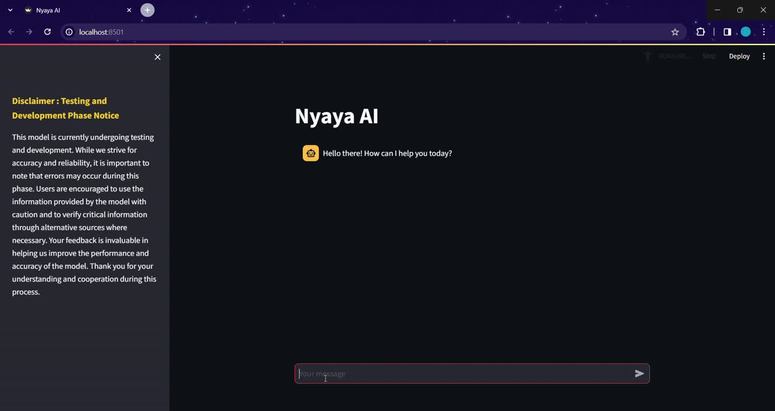
Our Value Proposition
this is our beta AI model
Subscription Fees: Monthly subscriptions for lawyers to access the platform.
Consultation Fees: Different rates for anonymous and non-anonymous consultations.
Premium Legal Templates: Pre-drafted legal templates available for purchase

Slide 9
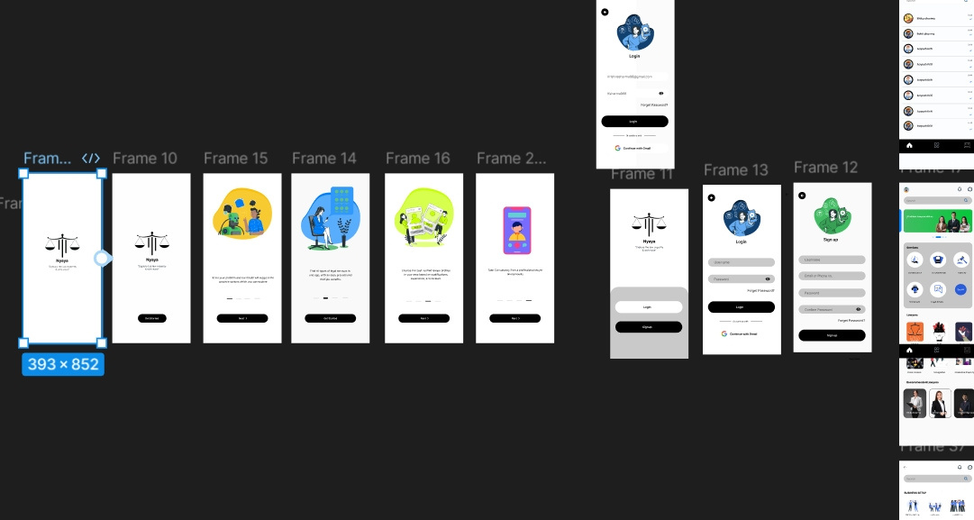
Opportunities for Growth
Expanding Services: Adding advanced legal research tools, contract review, and legal document drafting.
Geographic Expansion: Scaling operations to underserved global markets.
Corporate Partnerships: Collaborating with businesses to provide legal services for employees.
Government Partnerships: Working with government agencies to assist underserved populations.
AI Enhancement: Using cutting-edge AI to streamline legal research and service delivery.
this is a part of our design, coming soon in beta.

Slide 10
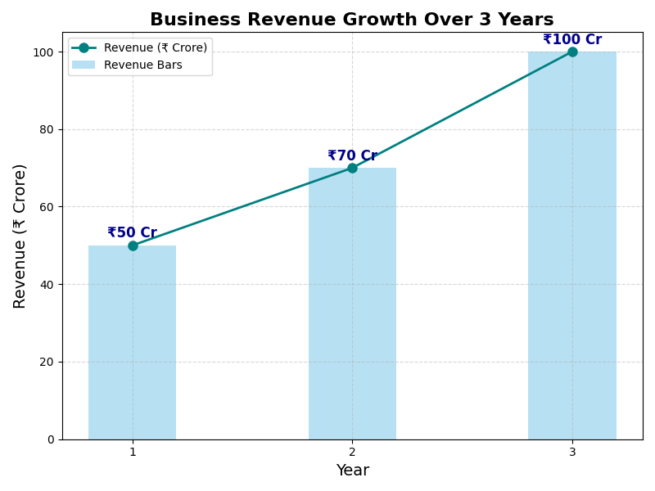
Financial Projections
Commercial Cases in India: As of September 2021, over 4.5 crore (45 million) cases were pending across all courts in India, with a significant portion being civil cases.
Even if Nyaya only captures 5% of the this its 50,000 cases

Slide 11
Beta Version
Design : click here
Website : click here

Slide 12
Thanks!

